Slide 1
Data-set
Mobile price classification (Kaggle) – contains sales data of mobile phones of various companies.
Includes 2000 observations of 21 variables – 8 qualitative and 13 quantitative variables.
Variables includes the information of various mobile phone features like ram, battery-power, number of cores , clock-speed, dual-sim, etc.
Target variable is a categorical variable having four price ranges.

Slide 2

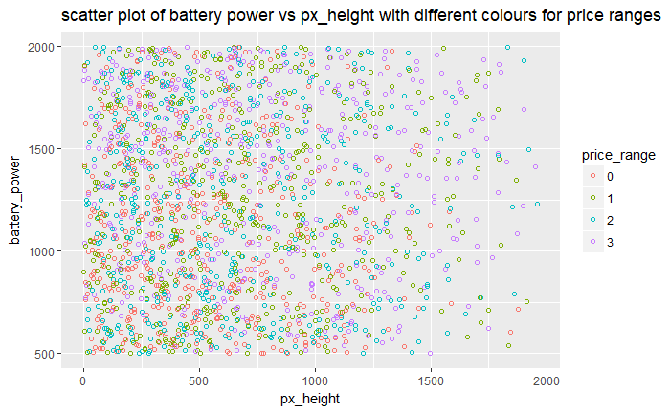
Problem definition
The objective is classifying each mobile phones into a given price range based on the features they include.
Target variable consists of four price ranges-0(very-low),1(low),2(medium),3(high).
Highly Non-linear : Upper right scatter plot of battery –power vs px_height shows that the data is highly non-linear.

Slide 3
Data Pre-processing
Creating dummies for categorical variables: There are 8 categorical variables which had to be converted into factors.
Standardizing Quantitative variables: There are 13 numerical predictors which had to be standardized by subtracting the column means and dividing it by its standard deviation
Separating the data into training and validation set: Data is separated into 60% for training and 40% for validation.

Slide 4
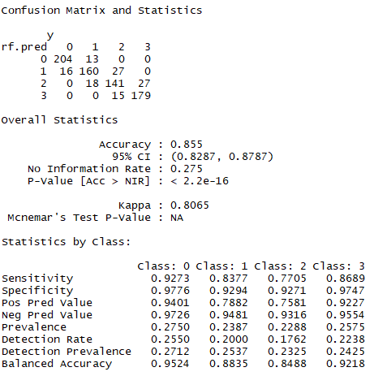
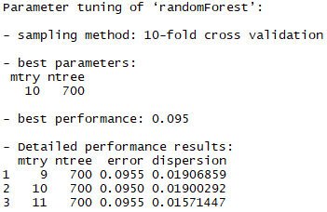
Random Forest Model
Random forest is the ensemble tree method which grows number of trees on the boot-strapped samples and uses subset of features for each split to reduce the correlation between the trees.
Random forest model is fitted and fine tuning is performed to identify the best hyper-parameters(no of features & no. of trees).
The best parameters obtained and performance of random forest on the validation set is shown in the figures.

Slide 5
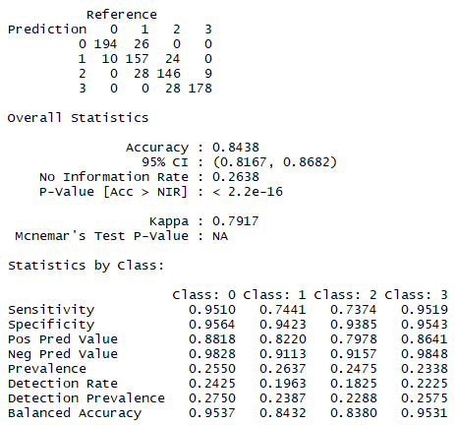
Multiclass Ada-boosting
In Ada-boosting , the weak learners are grown sequentially where the data is reweighted for every successive weak learners and all the weak learners are weighted individually to get the final classifier.
Multi Ada-boost model is fitted and fine tuning is performed to identify the best values for hyper-parameters(No. of iterations & shrinkage parameter).
The performance of Ada-boost on the validation set is shown in the figure.
Even after running 5000 iterations Ada-boosting did not outperform Random forest in terms of Accuracy.

Slide 6
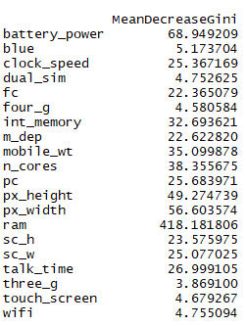
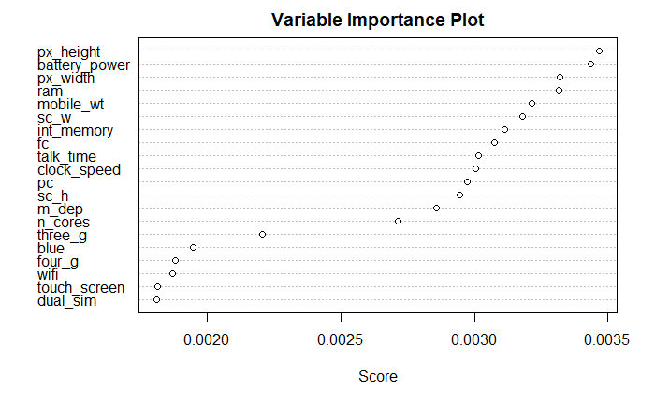
Variable importance
Random forest shows the mean decrease in Gini index for each variable which is a important measure to quantify the importance of variables.
Ada-boost also gives us a plot of variable importance which is shown in the figure.
Based on these plots, we can infer that the following variables : dual-sim, three-g, four-g, touch-screen and wi-fi contains little importance can be dropped.

Slide 7
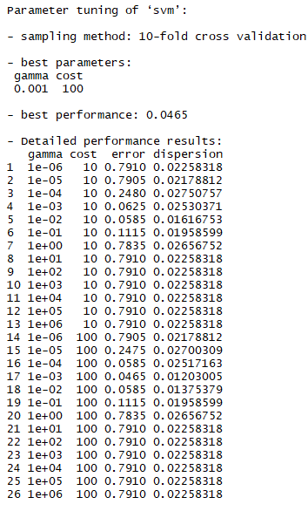
Support vector machine(SVM)
Since the data is highly non linear , support vector classifier with non-linear kernel will help us separating the data by projecting it into high-dimensional space.
SVM with Radial basis function kernel is fitted and fine tuning is performed to identify the best hyper-parameters(Gamma=0.001,cost=10).
The best parameters obtained and performance of SVM with RBF kernel on the validation set is shown in the figures.

Slide 8
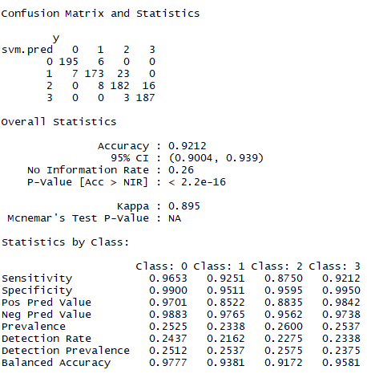
Performance of SVM with RBF kernel
As we can see , SVM model achieves the best accuracy of 92% outperforming both random forest and Ada-boosting.
The best hyper-parameter values are Gamma=0.001,cost=10 for Radial basis function.

Slide 9
Inference & conclusion
When the data is highly non-linear, using SVM with RBF kernel or polynomial kernel gives us a separating hyperplane by projecting the data into high-dimensional space.
Random forest performs better when we have both categorical and numerical predictors.
Performance of Ada-boost increases as the number of weak learners increases.
Both Ada-boost and Random forest can be used for finding the importance of variables .

